Slide 1
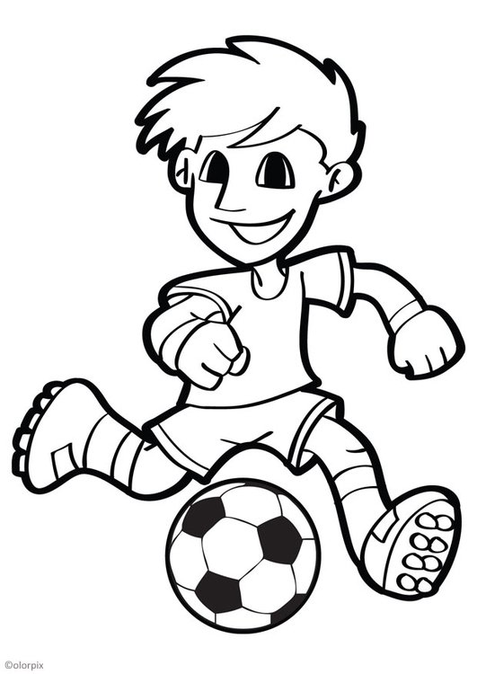
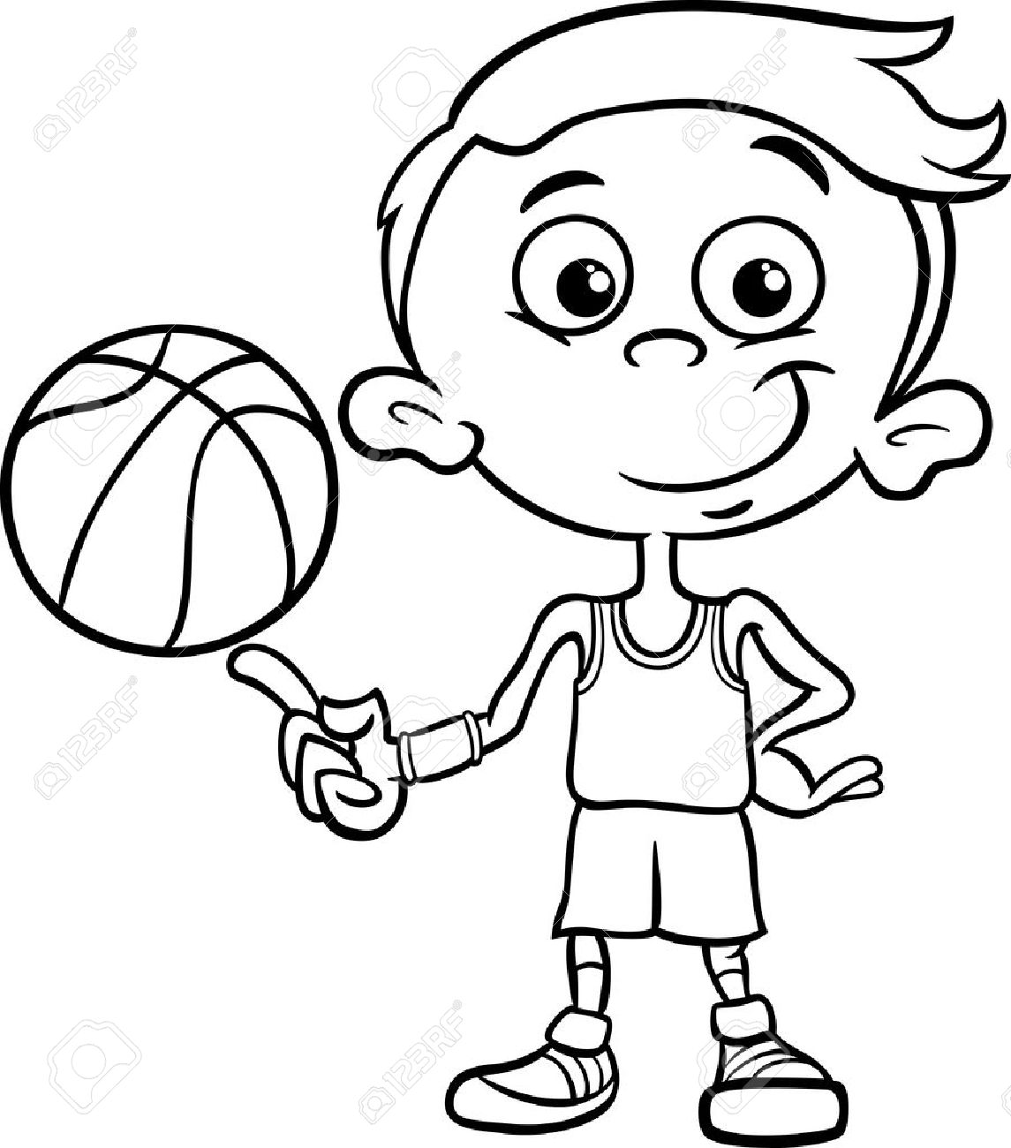
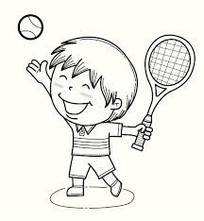
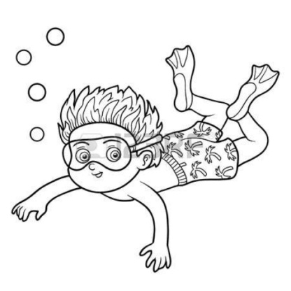
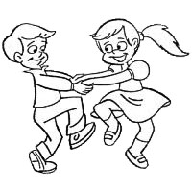
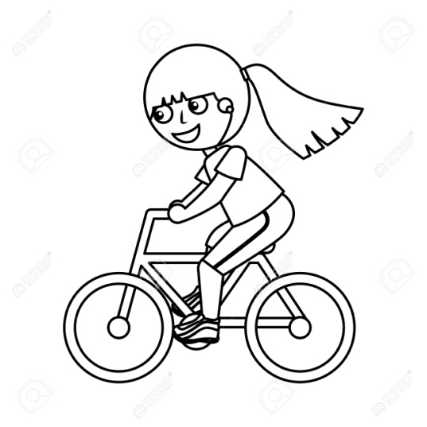
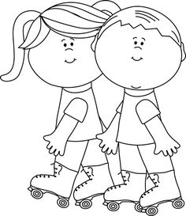
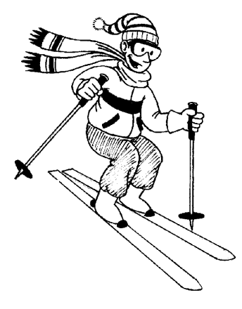
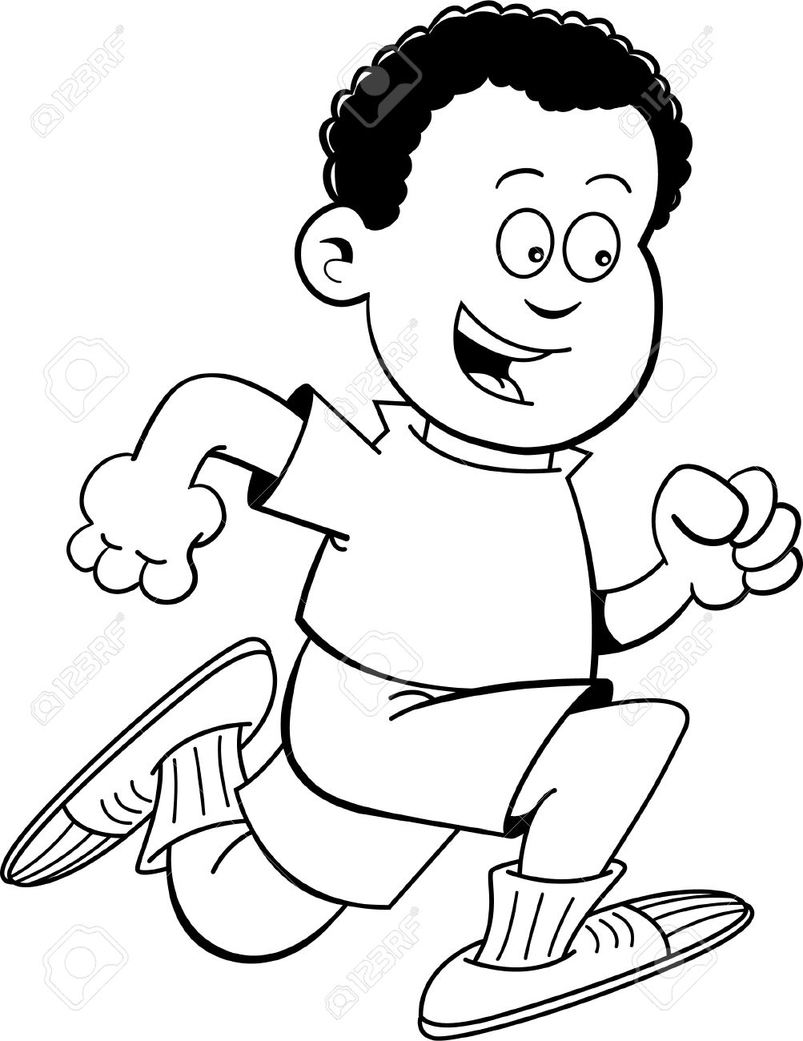

Slide 2
PLAY FOOTBALL

Slide 3
PLAY BASKETBALL

Slide 4
PLAY TENNIS

Slide 5
PLAY THE GUITAR

Slide 6
SING

Slide 7
SWIM

Slide 8
DANCE

Slide 9
RIDE A BIKE

Slide 10
ROLLER SKATE

Slide 11
SKI

Slide 12
RUN

Slide 13
Can you name the activities?

